Slide 1
Interim Project Presentation
Team Classified
Rama Prashanth
Bala Murali Manoghar

Slide 2
The Grand Challenge
Construction site at Mars
The robot and construction materials launched from earth using rocket and delivered to Martian surface using parachute.
The construction materials are spread out on the surface with few at known locations and few at unknown locations.
The Task
The mobile robot’s goal is to search for the colored blocks that represent the construction material.
The mobile robot has to pick up the construction materials and deliver the construction material to construction zone.

Slide 3
Task Breakdown
Robot Fabrication
Assemble the mobile robot using the resources provided.
Integrate different sensors and actuators to the mobile robot.
Image Processing
Identify red, blue and green blocks among other colored blocks are to be picked up.
Calculate the position of the blocks to be mapped to world coordinates
Control and planning
Device a control strategy to orient the robot towards the block to pick up properly.
Using the encoder reading from the wheels, localize the robot with respect to starting position. Also sue the encoder information to move the robot to a specific location.
Design and implement an algorithm to sequence the collection points of the identified blocks so as to reduce the time taken to deliver all the blocks to the collection zone.

Slide 4
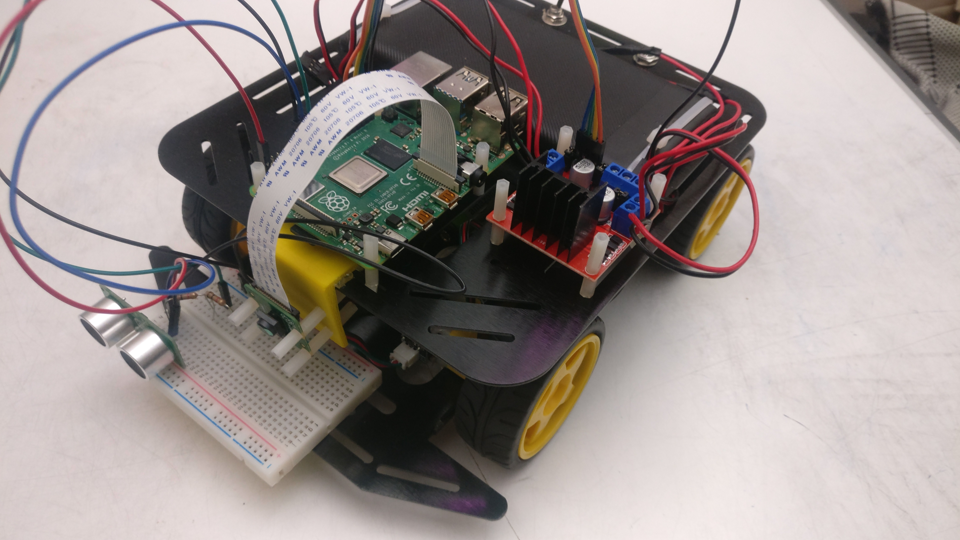
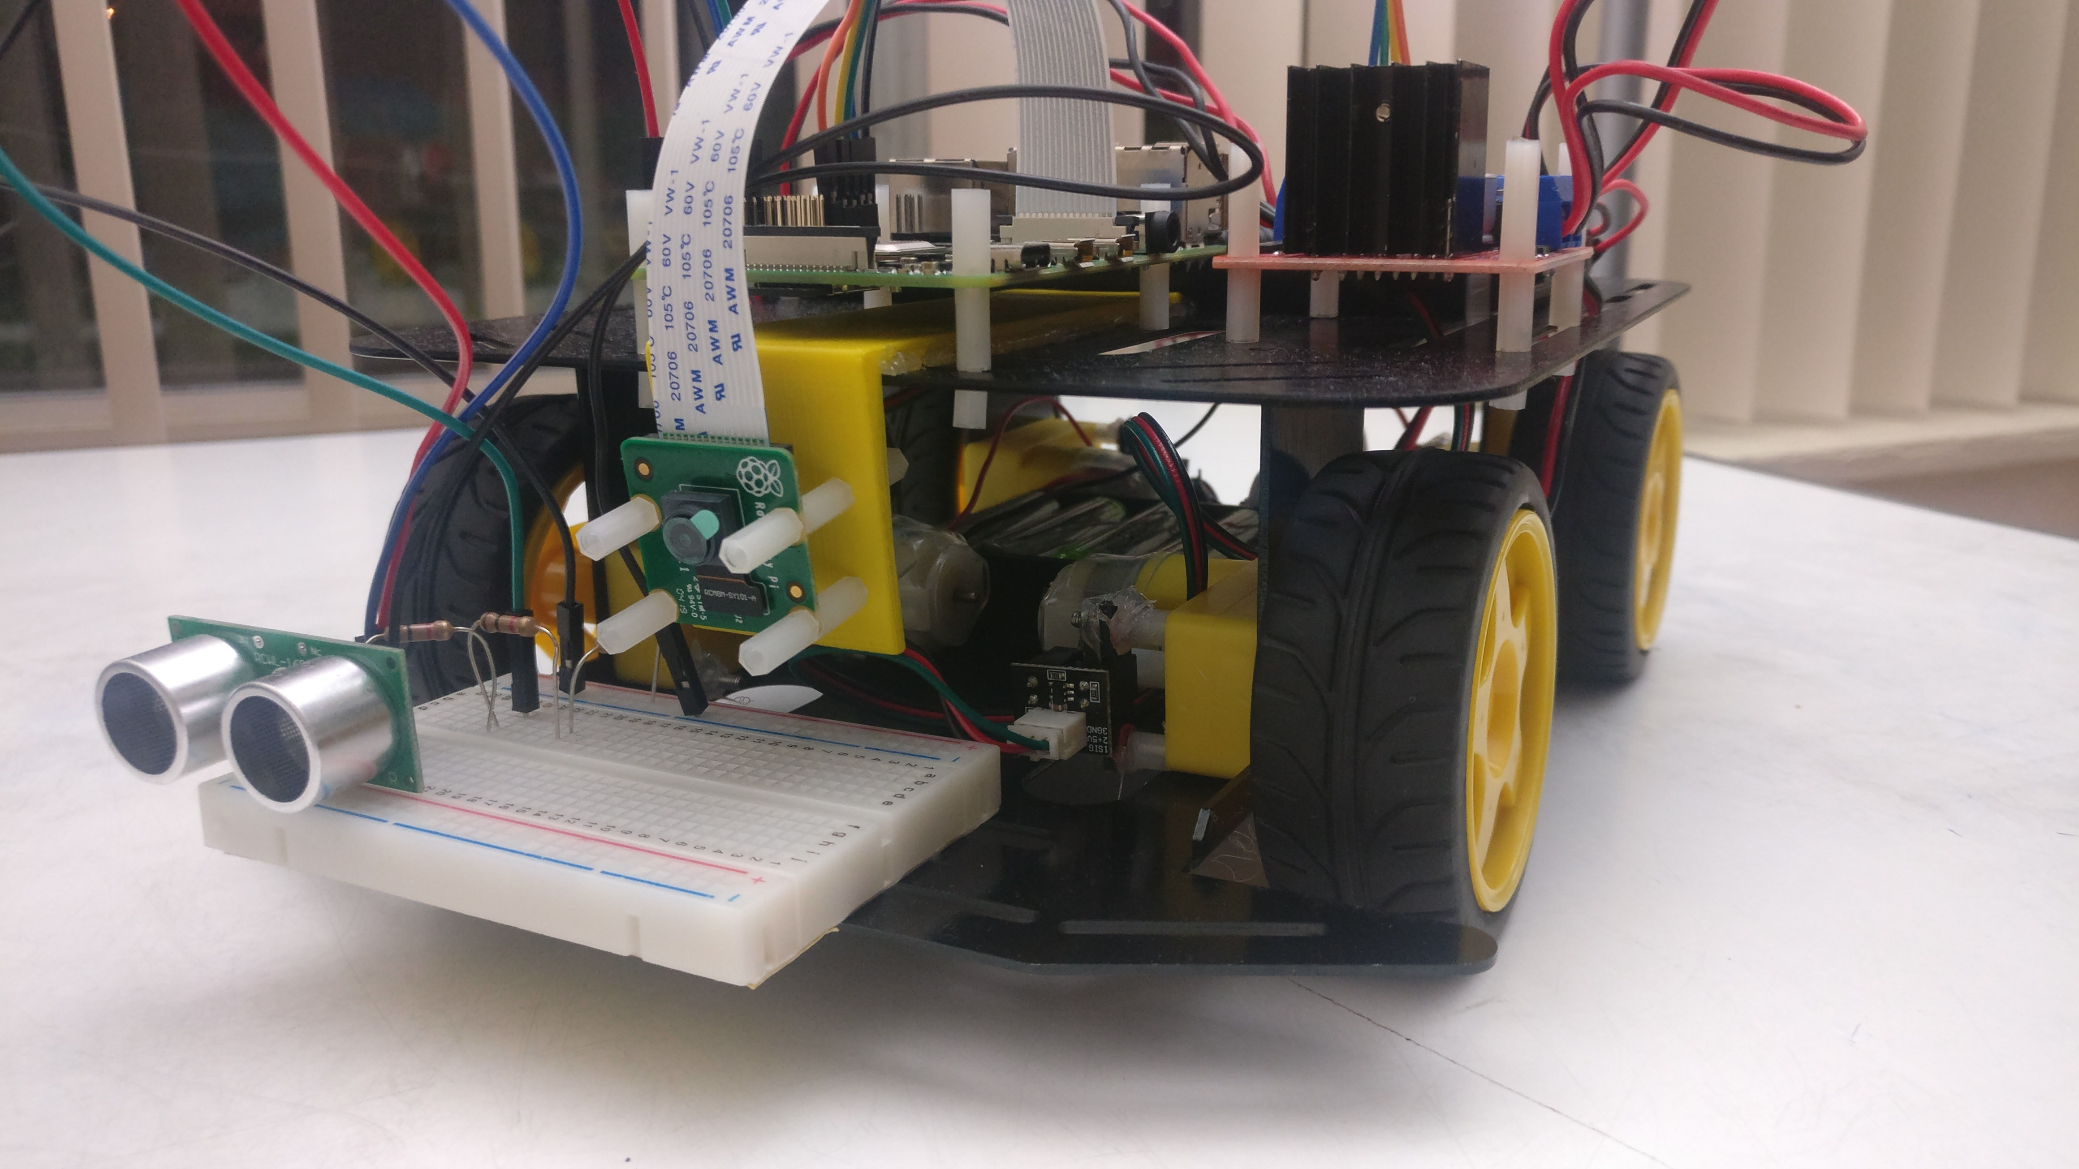
Progress to far
Hardware
Assembled the robot chassis
Fitted the motors, motor drive, ultrasonic sensor, raspberry pi, camera and batteries to the robot.
Testing
Tested camera operation and bench marked the performance through various tasks – 1, 2, 3.
Tested robot movement through teleoperation – Video.
Tested the ultrasonic sensor integration with raspberry pi – Image.
Autonomy stack
Preventing robot from running over obstacles – Used ultrasonic sensor measurement as a safety check before executing any robot movement commands.

Slide 5
Further Plan
Hardware
Assemble gripper mechanism and integrate to the robot.
Assemble IMU and microprocessor and integrate it to robot.
Testing
Test IMU integration with raspberry pi by reading the angles ad verifying the IMU data.
Test the connection with microcontroller by giving commands through serial read and write.
Test the gripper assembly by controlling the servo motor using PWM generated either from raspberry pi or through microcontroller.
Autonomy Stack
Come up with foraging strategy to identify the colored blocks and their position.
Use two PID controllers one to orient the robot towards the block and other to control the speed of robot based relative position of the goal point and obstacles in the surroundings.
Use a simple algorithm (A* or straight line) to plan path from current position to construction zone.
Integrate obstacle avoidance strategy (e.g., bug algorithm) avoid the robot from being run over blocks and hitting the walls.

